Slide 1
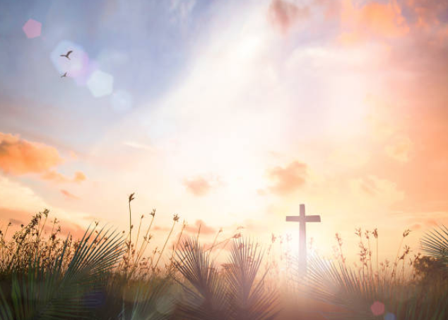
永活盼望
Living Hope

Slide 2
罪像道深渊，我与神隔绝
又如一高山，无法翻越
我在绝望中，举目向高天
呼喊祢名，入夜不眠
How great the chasm that lay between us
How high the mountain I could not climb
In desperation, I turned to heaven
And spoke your name into the night

Slide 3
祢的大慈爱，如一道明光，
透进我黑暗的心房
祢大工成就，结局已稳当，
基督是我，永活盼望
Through the darkness Your loving kindness
Tore through the shadows of my soul
The work is finished, the end is written
Jesus Christ, my living hope

Slide 4
何等大慈爱，有谁能想象？
无边的恩典，谁能度量？
永恒的真神，离荣美天家，
为我过犯担负代价
Who could imagine so great a mercy?
What heart could fathom such boundless grace?
The God of ages stepped down from glory
To wear my sin and bear my shame

Slide 5
十架上宝血，宣告祂宽恕，
宇宙主称我为儿女
荣美的救主，我永远归属
基督是我，永活盼望
The cross has spoken, I am forgiven
The King of Kings calls me His own
Beautiful Savior, I’m yours forever
Jesus Christ, my living hope

Slide 6
哈利路亚，赞美主给我自由
哈利路亚，祢的名带来拯救
祢打碎一切枷锁，死亡不再捆绑我
基督是我，永活盼望
Hallelujah, praise the one who set me free
Hallelujah, death has lost its grip on me
You have broken every chain
There’s salvation in your name
Jesus Christ, my living hope

Slide 7
哈利路亚，赞美主给我自由
哈利路亚，祢的名带来拯救
祢打碎一切枷锁，死亡不再捆绑我
基督是我，永活盼望
Hallelujah, praise the one who set me free
Hallelujah, death has lost its grip on me
You have broken every chain
There’s salvation in your name
Jesus Christ, my living hope

Slide 8
那荣耀清晨，救赎工完成
复活的基督，走出坟墓
祂打破寂静，宣告神得胜，
死亡毒钩已被去除
Then came the morning that sealed the promise
Your buried body began to breathe
Out of the silence, the roaring lion
Declared the grave has no claim on me

Slide 9
那荣耀清晨，救赎工完成
复活的基督，走出坟墓
祂打破寂静，宣告神得胜，
死亡毒钩已被去除
耶稣已得一切胜利
Then came the morning that sealed the promise
Your buried body began to breathe
Out of the silence, the roaring lion
Declared the grave has no claim on me
Jesus yours in the victory

Slide 10
(会众) 哈利路亚，赞美主给我自由
哈利路亚，祢的名带来拯救
祢打碎一切枷锁，死亡不再捆绑我
基督是我，永活盼望
Hallelujah, praise the one who set me free
Hallelujah, death has lost its grip on me
You have broken every chain
There’s salvation in your name
Jesus Christ, my living hope

Slide 11
哈利路亚，赞美主给我自由
哈利路亚，祢的名带来拯救
祢打碎一切枷锁，死亡不再捆绑我
基督是我，永活盼望 (x3)
Hallelujah, praise the one who set me free
Hallelujah, death has lost its grip on me
You have broken every chain
There’s salvation in your name
Jesus Christ, my living hope

